Slide 1




[Building] GUI Testing Automation Framework
Nicolae Oprean
QA Technical Expert

Slide 2

Who am I?
Nicolae Oprean
QA Technical Expert at Ullink
PhD in Computer Science
Programmer (1y), Client Service (5y) and QA (8y)
Notes:
Nicolae Oprean - QA Technical Expert at Ullink
PhD in Computer Science
Work experience: Programmer (1y), Client Service (5y) and QA (7y)
Ullink provides trading solutions for financial markets;
500+ employees around the world in 10 different offices
In the next 30-40 minutes we will discuss about code review process for test automation in order to get a Strong Review Culture for QA:
Initial problems;
When we decided to focus on automation;
How we implemented Code Review process;
Benefits of Code Review;
Rules for Code Review;
Git and Gerrit integration;
Foreman role in Software Development;
Review Tips and Lessons Learned

Slide 3

Why Automated Testing?
Questions:
What Is The Benefit of Test Automation and Why Should We Do It?
Always automation is recommended?
Notes:
Automated Testing Saves Time and Money
Automated Testing Helps Developers and Testers
Increases Your Test Coverage

Slide 4
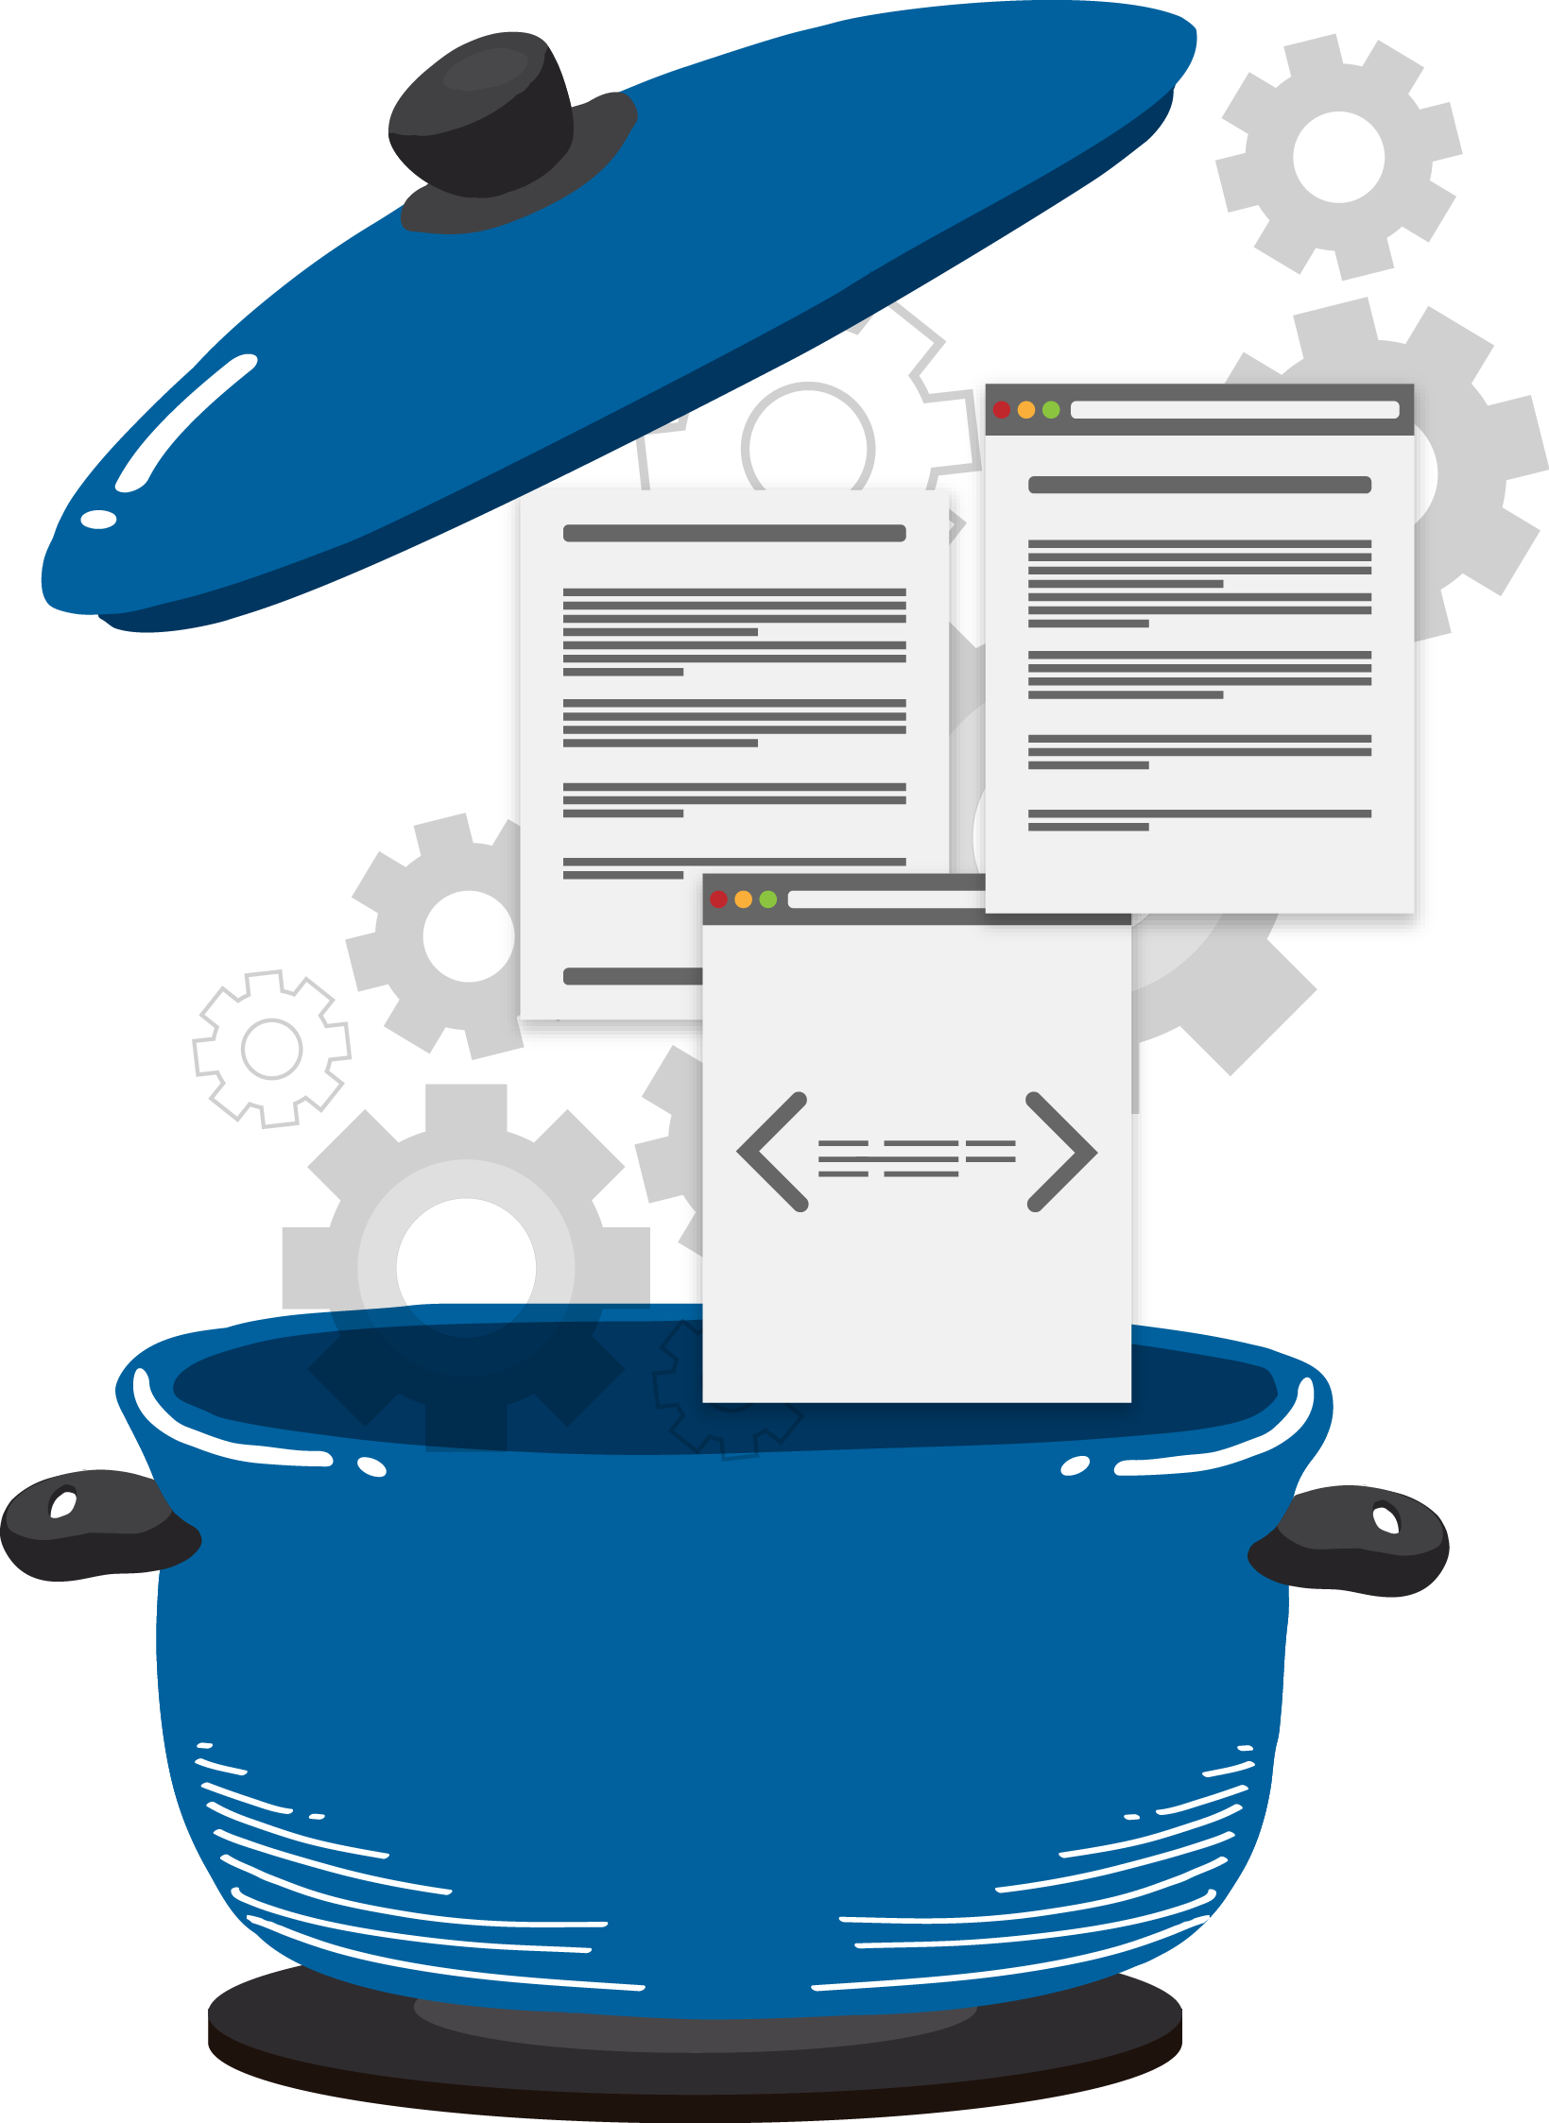
Perfect recipes
No such thing
Variables to influence
Project type
Period
Business
Technology
Notes:
Project type / period / business / technology /
Even testers and the team, up to management, everyone influences the outcome of a project.

Slide 5
Workshop Plan
There are several phases:
Present Application
Choose & setup your environment: Application, TestComplete, MySQL etc.
UI Elements, Objects Store, identify objects
Application – record and play, start building your first script
Start Building the framework on three levels (Common, Business and TestCases):
Exercise: TextBox Type, Menu Selection
Create first customer using inline data
Introduce test case xml files, working with dictionaries
Create first animal data using dictionaries
Build test plan with single start of the application

Slide 6
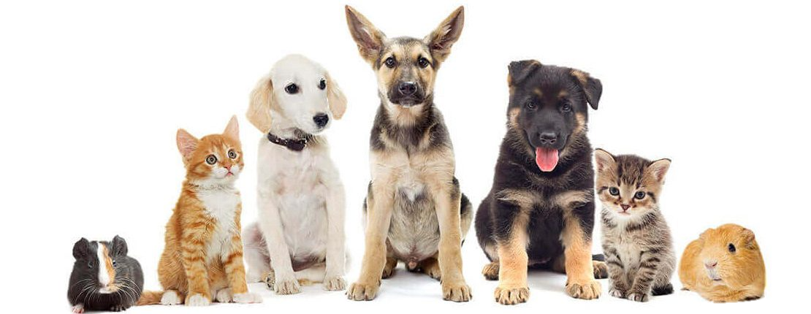
Present application

Slide 7
What tool to use for Automation
Research on what tool to choose ?
What they offer?
Easy to integrate?
Previous experience? (reluctant to something new)
Ranorex, Rapise, Abbot, AutoIt, TestComplete, Selenium etc
Comparison Matrix (required language, object recognition, reporting, costs…)
Notes:
JavaScript, Python, VBScript, Jscript, DelphiScript, C#, and C

Slide 8
Setup
Download free trial version of TestComplete
https://smartbear.com/product/testcomplete/free-trial/
Must have a GitHub account and being able to access test app:
https://github.com/nickoa2001/
Download and install open source VetTev Veterinary Cabinet GUI App:
https://sourceforge.net/projects/vettev/
Have MySQL installed on local PC or install Wamp Server package from here:
http://www.wampserver.com/en/ (it will require Microsoft Redistributable Package to be installed)
Download and install open source GNUCash app
https://sourceforge.net/projects/gnucash/

Slide 9

How to create a new Project in TestComplete?
Project Path
Configure Tested Application
Choose Scripting Language
Object browsing
DOM Elements on Web
Supported Desktop Apps
Visual Basic 6
Delphi
Java
JavaFX
FoxPro
Microsoft Access
Microsoft InfoPath
.NET
WPF
Visual C++

Slide 10
Record and play
How to?
Advantages
Disadvantages – when not okay
- If different test data – different test

Slide 11
UI elements
In Test Complete all DOM elements are seen as objects
Enable MSAA for custom objects - Microsoft Active Accessibility (MSAA)
Examples: button, text field, drop down, calendar, grid
Notes:
MSAA - is a technology that lets applications provide information about their
user interface to other software, for example, screen readers.

Slide 12
Process Method
TestObj.Process(ProcessName, ProcessIndex)
TestObj | A variable, parameter or expression that specifies a reference to one of the objects listed in the Applies To section
ProcessName | [in] | Required | String
ProcessIndex | [in] | Optional | Integer | Default value: 1
Result | A Process object
https://support.smartbear.com/testcomplete/docs/reference/test-objects/members/sys/process-method-sys-object.html?q=Sys.Process

Slide 13
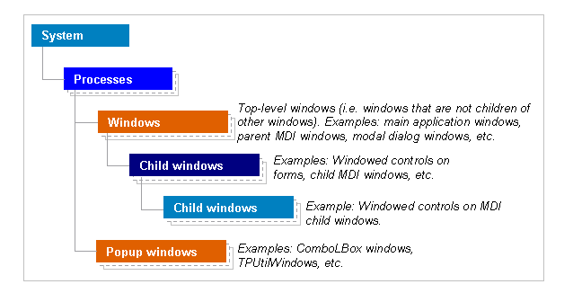
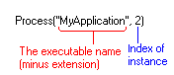
Process Object
The actual process is obtained through the Sys.Process() function

Slide 14
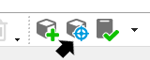
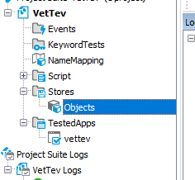
How to create an Object?
Use the Objet Spy
Create New Objects Store
Notes:
MSAA - is a technology that lets applications provide information about their
user interface to other software, for example, screen readers.

Slide 15
Naming objects
Good Naming vs. Bad Naming
Good practices in Confluence page
Examples with good and bad naming - inconsistency
{
Close
Animals_Button_Add
Buttons_delete
DeleteButton
Name
Customers_TextBox_Email
}

Slide 16
Exercise
1
2
3
4
Capture and name objects
Check objects properties
Store location
Store objects with different properties

Slide 17
Framework Design
Automation Framework
(Test case reporting, Test Set Creation, error management)
Business Components
Business Components
Business Components
Pharmacy App
VetTev Application
Messaging App
Object repository
Object repository
Object repository
Reference
Reference
Common functions
(Library of possible actions per object type, for ex function TextBox_Type, ComboBox Select)

Slide 18
FindChild – First common method
TestObj.FindChild (PropNames, PropValues, Depth, Refresh)
TestObj | A variable, parameter or expression that specifies a reference to one of the objects listed in the Applies To section
PropNames | [in] | Required | Variant
PropValues | [in] | Required | Variant
Depth | [in] | Optional | Integer | Default value: 0
Refresh | [in] | Optional | Boolean | Default value: True
Result | Object
https://support.smartbear.com/testcomplete/docs/reference/test-objects/members/common-for-all/findchild-method.html?q=FindChild

Slide 19
Common Layer
Common Application
Common ComboBox
Common Data
Common Dictionary
CommonFiles
Common Reporting
Common TextControl
Common
GridControl
Common
TabControl
CommonObjects
Notes:
Common Application – Start/Stop Application, Check Process Running
CommonCoboBox – Type, SetText, ClickItem
CommonData – Get Data from XML and store data in dictionaries
CommonDictionary – Create, Empty, Delete Dictionary, Count Elements, Update Ditionary
CommonFiles – Copy File, Delete File, Store Results, Check Files Exist
CommonObjects – Find Object, Find Object by property Name, Check Object property,
CommonReporting – Initialize test cases, handle errors, store test results in Project Variables
CommonTextControl – TextBox Type, Get Text
CommonGridControl – Get Row Count, Check cell value
CommonTabControl- Check Tab Exist, Select Tab

Slide 20
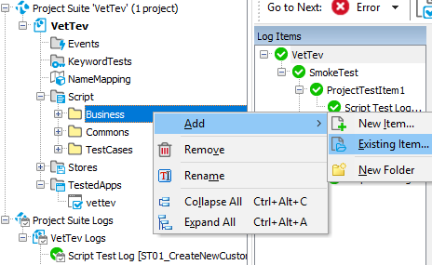
First business library
Referencing Common Libraries
Referencing other Business Libraries
Add -> Existing Item, an external reference
Add “//USEUNIT scriptname” at the top of the script
Exercise:
create a method to type inside a textbox control some value
create a method that selects a tab inside the Application Menu

Slide 21
Business Method naming conventions
Exercise:
Let them write their own methods – with bad names
Make them switch Pcs and see if they understand what theirs colleague did – if the name is suggestive enough
Examples of bad method naming
Examples of good practices and advantages:
One module = one screen
Module name = screen name
Modules are grouped by functionality
If the same screen is used for creation and modification, the module is called AddEdit<module> Example: AddEditCustomer
Alternatively you can highlight inside the name the business action performed on that module: ModuleName_<ActionName> Example: Customers_FillCustomerName

Slide 22
Business Layer
Contains business logic functions
Aim: list recurrent actions to improve test case writing and maintenance
Examples of the customer business functions:
Fill Customer Details;
Get Customers Count;
Delete customer Entry;
Need: All data must be accessible in the business layer
Problematic: Handling a lot of information can be confusing

Slide 23
Data management
Idea: implement dictionary to group associated data
Each business module is linked to a dictionary
Functions of a business module use data of the dictionary
Example in function Customers_FillCustomerDetails():
TextBox_Type(Objects.Customers_TextBox_Name, CustomersData_GetParameter("Name"));
TextBox_Type(Objects.Customers_TextBox_Email, CustomersData_GetParameter(“Email"));

Slide 24
Adding data to dictionary
XML files will be used to affect data to the dictionary
Each test case will be linked to one XML data file
Data must be defined per test step
Content of the dictionary is predefined

Slide 25
XML Sample
//USEUNIT CommonApplication
………………………………………
function ST02_CreateTwoNewCustomers_UsingDictionaries()
{
Log_InitTestCase("ST02_CreateTwoNewCustomers_UsingDictionaries", “Add two customers");
Log_CurrentStep("Step 1: Select new Customers tab and click on Create New Button");
CommonApplication_StartApplication(10000);
MenuBar_SelectCustomersTab();
Customers_ClickButtonNew();
Log_CurrentStep("Step 2: Create new customer using xml dictionary data");
CustomersData_UpdateDictionaryFromXML
("ST02_CreateTwoNewCustomers_UsingDictionaries", "FirstCustomer")
Customers_FillCustomerDetails();
Customers_ClickButtonSave();
Log_CurrentStep("Step 3: Create another customer using dictionaries");
CustomersData_UpdateDictionaryFromXML
("ST02_CreateTwoNewCustomers_UsingDictionaries", "SecondCustomer");
Customers_ClickButtonNew();
Customers_FillCustomerDetails();
Customers_ClickButtonSave();
Log_CurrentStep("Step 4: Close the application and store results");
CommonReporting.Log_CurrentTestCaseStatusPass();
}
File: ST02_CreateTwoNewCustomers_UsingDictionaries.xml
<TestCase>
<TestStep id="FirstCustomer">
<Dictionary id="Customer">
<Name>Natasha</Name>
<Surname>Oprean</Surname>
<Phone>074568798</Phone>
<Email>natasha.oprean@gmail.com</Email>
<City>Cluj-Napoca</City>
<Street>Dunarii</Street>
</Dictionary>
</TestStep>
<TestStep id="SecondCustomer">
<Dictionary id="Customer">
<Name>Sanziana</Name>
<Surname>Boanca</Surname>
<Phone>0722238798</Phone>
<Email>sanziana.boanca@gmail.com</Email>
<City>Cluj-Napoca</City>
<Street>Oltului</Street>
</Dictionary>
</TestStep>
</TestCase>

Slide 26
My first test
Create/Update common functions needed for the business scenario
START
Make sure you have all objects captured

Slide 27
My first test
Build Test Case Steps
Create/Update Business methods to cover test scenarios

Slide 28
Let’s make things rolling
Create test case scenario for Animals View
Run the test and check the results
Make sure you have business data dictionary defined for Animals view
Build the business module for Animals
If missing Common Functions create them

Slide 29
Am I ready?
Have all test cases clearly defined
Create, update or reference Business Libraries
Reference and use the right Common Library
One step at a time
Error handling
General Events handling
Organize your tests in Test Suite -
Single App Start?
Test Results and reporting - Email, Elastic Search, Kibana
Integrate with Jenkins, Git and Gerrit
Code Review

Slide 30
Summary
Know your application
Define Test Scenarios to be automated
Objects Store
Start Building Common Functionality
Business Functionality – Create, Update, Reference, Expose
Reports and Test Coverage
Organize test sets and integrate with Jenkins
Create your automated tests

Slide 31
Questions?
Nicolae Oprean
QA Technical Expert
Twitter: @noprean
Email: nicolae.oprean@itiviti.com
Linkedin: nicolae-oprean

